Slide 1

UTS
CLOUD COMPUTING 2019

Slide 2


Anggota Kelompok :
Panji Iman Baskoro
17111023
Melanaumi Apriza
Fahira Sa'i
171111110

Slide 3




Slide 4

Datacenter Location:
Indonesia (a member of infinsys company)
Plus about cloudkilat (+) :
Interesting service and product plan
Cheap Price for newbie users or small company
24/7 Customer Service & Customer Support
A good relation with local community such as KLIM
Minus about cloudkilat (-):
It’s feature is limited, the cause is business purpose
And further more it’s feature is just “enough”
Only Available in Indonesia

Slide 5
Feature
Kilat VM 2.0 SSD Start from Rp 90.000/Month
Kilat Storage Start form Rp 30.000/month (Object Storage)
Kilat IRON PaaS Start from Rp 45.000/month support container docker
Kilat Hosting Start from Rp 50.000/month
Kilat Plesk VM + Plesk Panel Rp 350.000/month
Add-on feature
Panel kontrol, Apps management, SSL, Domain

Slide 6

Lokasi Datacenter :
czech, Italy, France, Germany, United Kingdom, Poland
Plus about arubacloud (+) :
runGlobally available across europe and america
Free Trial for 10 Euro
Add on services
Cloud PaaS Jelastic*
Minus about arubacloud (-):
Frequently reported down
Bad Customer Services
The Service is making customer Go Away (by hostadvice.com )

Slide 7
Feature
Cloud VPS Start from €2.79+VAT/month vmware
Cloud PRO Start from €2.79+VAT/month vmware/v-sphere (on-premiese cloud)
Jelastic PaaS & CaaS mulai dari €25.99+VAT/month Jelastic PaaS Cloud Platform
Add-on Feature :
Cloud Backup, Cloud object Storage 3S, Private Cloud, Cloud Monitoring

Slide 8
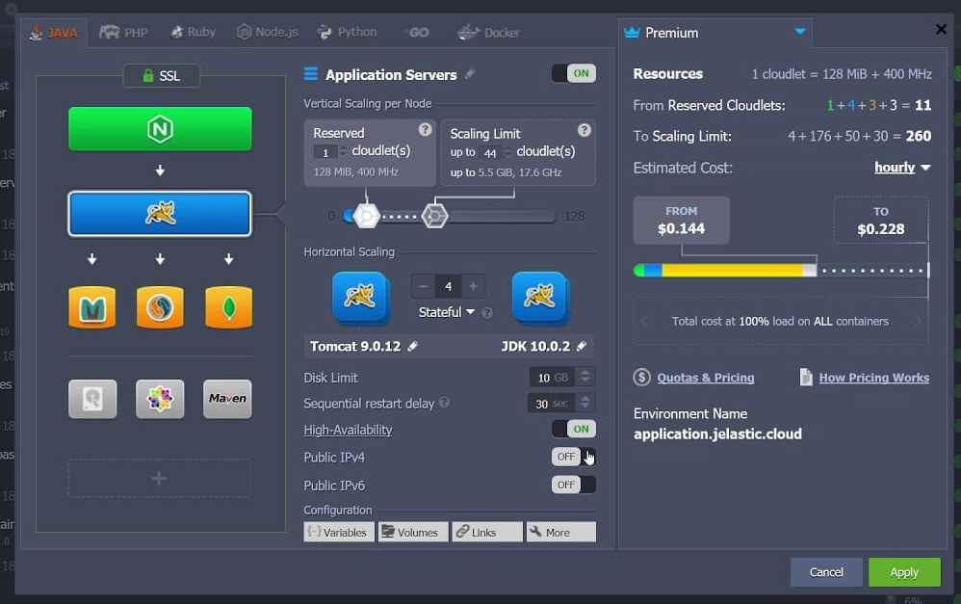

X

Slide 9
KESIMPULAN

Slide 10
From technical prespective aruba is the winner, but from business prespective cloudkilat is more efective
Both aruba and cloudkilat market is very competitive. Aruba starting to ambush asia market, mean while Cloudkilat is still consistent in local Indonesian market.

Slide 11
Terimakasih

